Slide 1






Outsmarting the Cookie Apocalypse
Unleashing the Power of 1st Party Data
Team Name:
Then There Were Three
02

Slide 2



Meet The Team
Anchal Chaudhary
Anisha Samant
Shubham Kumar
chaudhary@ucdavis.edu
aasamant@ucdavis.edu
shku@ucdavis.edu
Math and CS graduate UIC
MS in Business Analytics student at UC Davis
2 years of Start-up experience handling Analytics and Operations
MS in Business Analytics student at UC Davis
4+ years of Data Science and Business Consulting experience in telecom industry
MS in Business Analytics student at UC Davis

Slide 3
Business Problem: What are we trying to solve?
Problem With the drop in 3rd party cookies by Google, HP needs to renew focus on 1st party data for marketing
Solution Identify key customer segments, mapping customer & product journey, propensity signals for printer repurchase
Impact Create targeted campaigns, improve customer retention and product recommendation: increasing revenue and satisfaction.

Slide 4

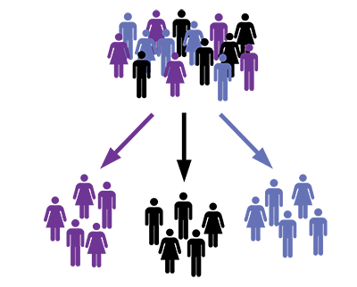
Objective
1st Party Data: We focus on our own data to gain a deeper understanding of our customers and provide personalized experiences.
Customer Segmentation: By analyzing the purchase & usage patterns and preferences of customers in each cluster, we can identify the most popular and high-end printers and implement targeted marketing strategies.
Predictive Modeling: We can maximize conversion rates and lifetime value by analyzing customer data and tailoring campaigns.

Slide 5

THE DATA

Slide 6
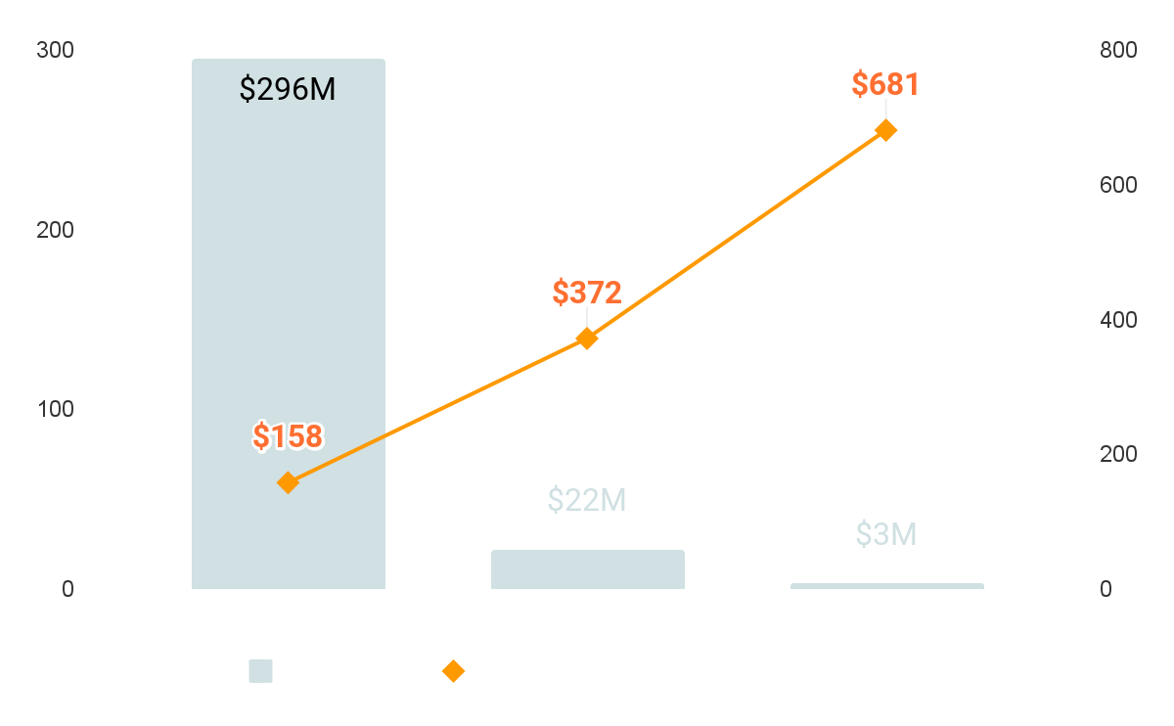

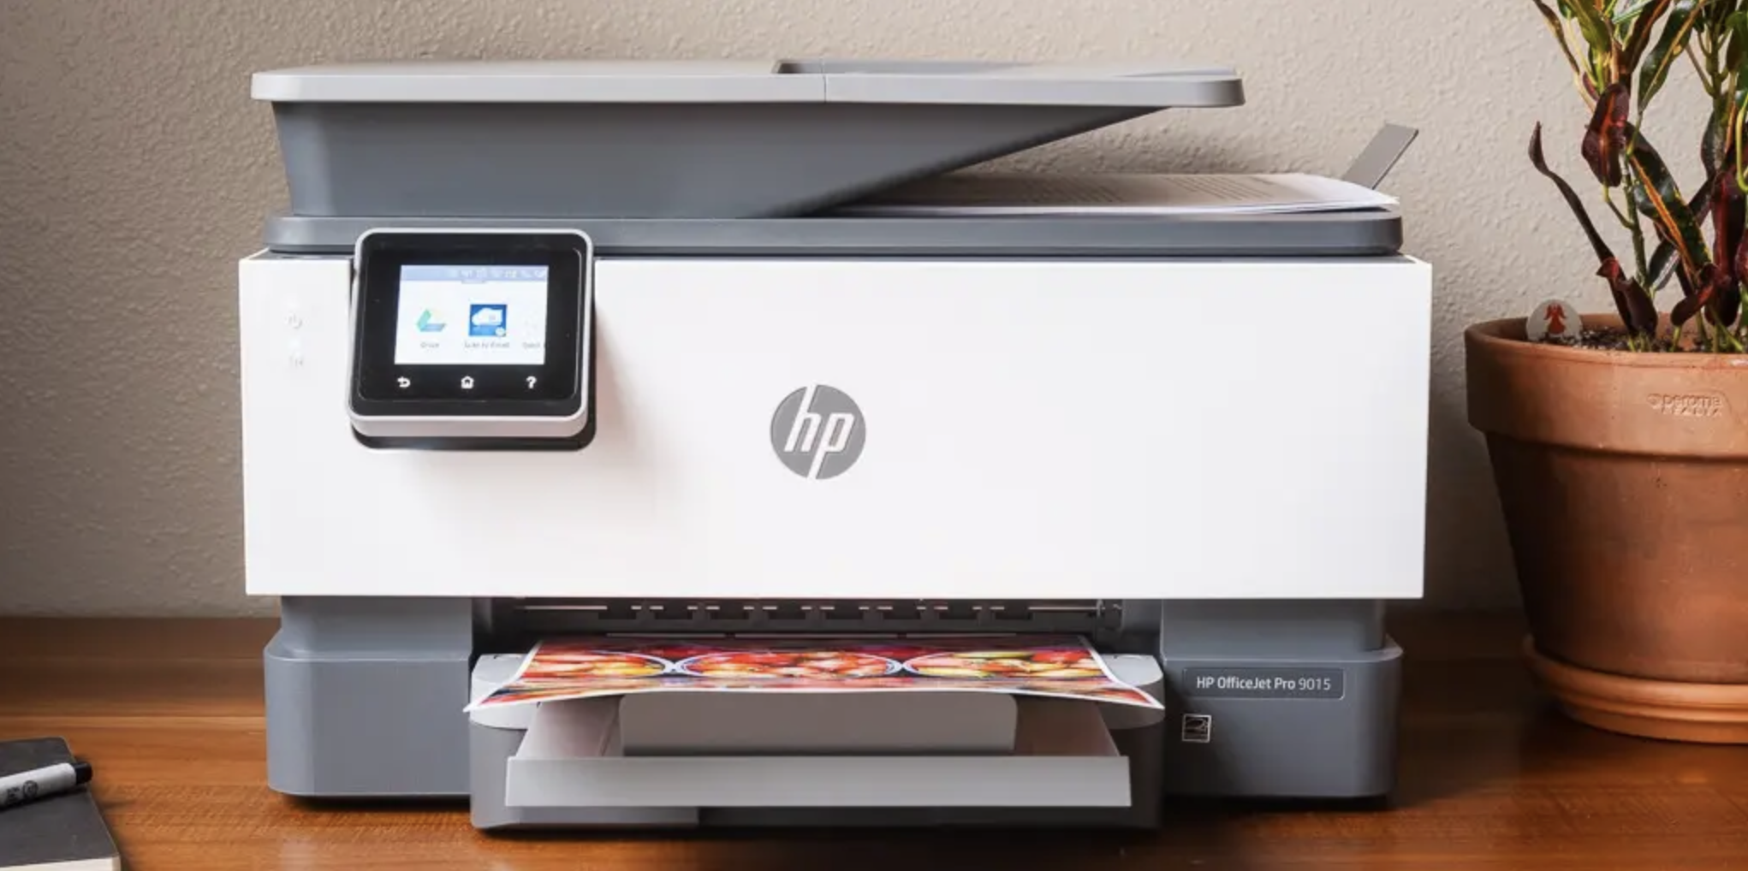

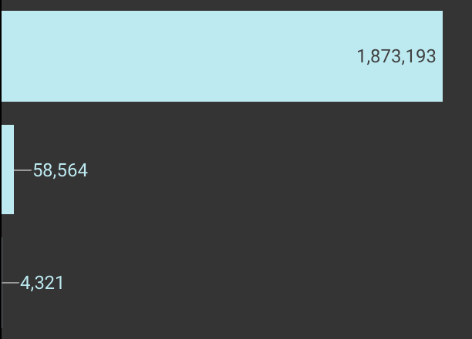
Revenue Breakdown based on how many printers a customer purchases
The data has following features and attributes:
Printer Usage:
Account Features:
Total Ink Usage
HP Ink usage
No. of Pages Printed
MDM ID (Customer ID)
Serial Number (Printer ID)
Demographic:
Derived Features:
Age
Gender
Occupation
Household Income
% Days printer is active
% Days Subscribed
Total Revenue by Cust
1
2
2+
Number of customers purchases 1,2 and 3+ printers
There are more features which are not present in this illustration
Notes:
2nd Visualization done in Looker to analyze how many of the customers in our dataset are buying 1 printer, 2 printer and more than 2 printers. This would give us an idea about how much percentage of our dataset are customers who have repurchased printers.
We calculated revenue and count of customers in each said category

Slide 7
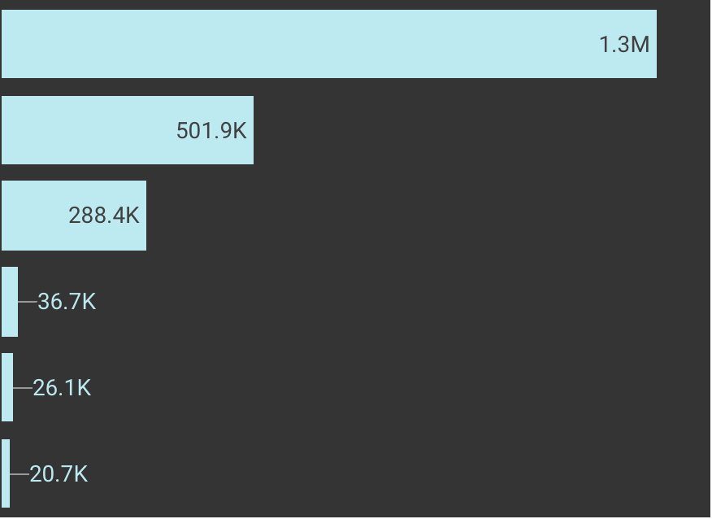
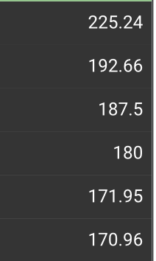
~60% of the customers are classified as loyal and account for 65% of the base revenue
Average Revenue Each Loyalty Class
Loyal
Host
Only
Disloyal
Suspect
Only
Non HP
Only
No Ink
Consum
Suspect Only
Non HP Only
Printers Purchased by Each Loyalty Class
Host Only
Loyal
No Ink Consumption
Disloyal
Notes:
Exploring the data on looker by customer loyalty class
From the total number of printers purchased by each loyalty class, we can observe which loyalty classes have the most and least number of customers. We can see that the loyal class has the highest number of customers, followed by Host Only and Disloyal classes. This could indicate that the majority of customers prefer using HP original cartridges or authorized third-party cartridges.
From the average revenue generated by each loyalty class, we can observe the amount of revenue generated per printer on average by each loyalty class. We can see that Suspect Only class generates the highest revenue per printer on average, followed by Non HP Only and Host Only classes. This could indicate that customers who use non-HP cartridges, either authorized or unauthorized, are willing to pay more for them, or that they print more frequently than customers who use HP original cartridges.
Based on these observations, we can use loyalty class as a customer segmentation variable, as it can help identify different groups of customers with distinct purchasing behaviors and revenue generation patterns. This information can be used to tailor marketing strategies and product offerings for each loyalty class to optimize revenue generation and customer satisfaction.
*Visualizations done on Looker
*Before beginning our analysis, visualization and data modeling exercise, we deleted duplicate rows, duplication on serial number (~100K cases). If two or more rows with the same MDM_ID had the same serial number, they were assumed to be duplicates. We retained only one row which had the maximum number of information in other columns, and deleted the remaining row(s)*

Slide 8

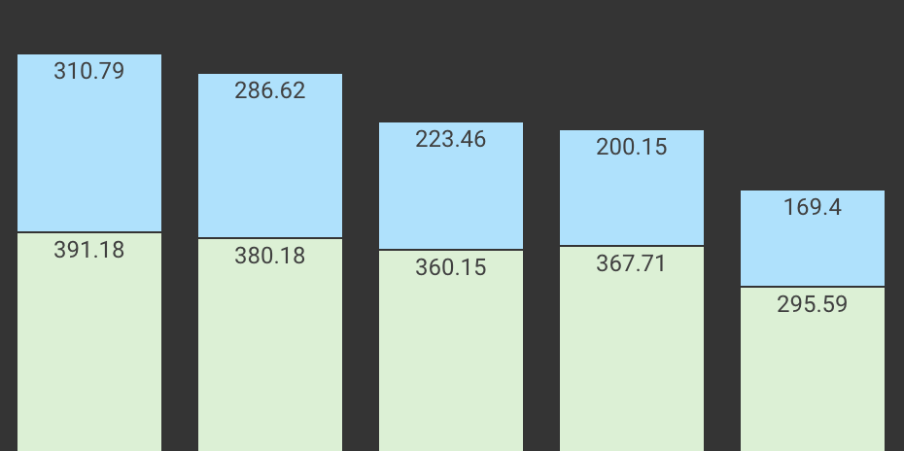
Average Revenue by customer business environment
Office Users generate more revenue across the segments
Printers
Multifunctions and All-in-One
Top 5 Printers for each category
Office | Home
HP OfficeJet Pro 9015 All-in-One | HP ENVY 5055 All-in-One
HP OfficeJet Pro 8710 All-in-One | HP ENVY 6055 All-in-One
HP OfficeJet Pro 9025 All-in-One | HP ENVY Photo 7855 All-in-One
HP OfficeJet Pro 8025 All-in-One | HP OfficeJet Pro 8025 All-in-One
HP OfficeJet Pro 9018 All-in-One | HP ENVY Pro 6455 All-in-One
Office>=10 Office < 10 Office Size Home Home
Unknown Business Personal
Notes:
Exploring data on looker, segmenting by customer type- whether they are an office or a Home User. We calculated the average revenue by customers type, segmented by Product type.
We also identifies the top 5 printers in each category.
As expected, Business customers have more per customer revenue than Home customers
Visualizations done in Looker: https://lookerstudio.google.com/reporting/3b6c9b10-07d2-4c82-ab82-30c31d7a7774

Slide 9

INSIGHTS

Slide 10
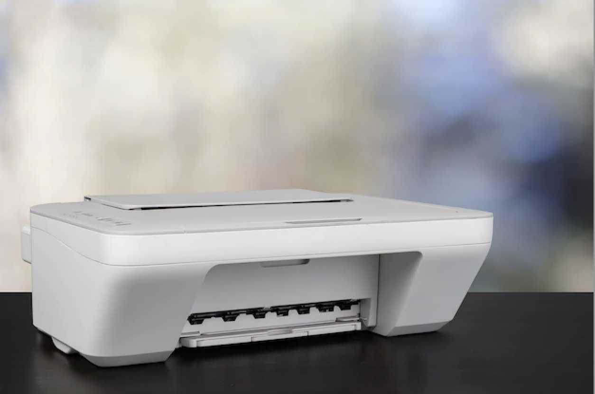
~80% Customers subscribe on or before day of first print
~3% in the first month
~17% after first month
Printer Journey, Break down
Mapping the average journey of an HP Printer
Printer starts printing
(Base: ~2M
Printers)
Day 1
Printer’s last print job
Day 428
Printer becomes Obsolete (~72K, 4%)
Day 517
Customer unsubscribes to Instant Ink (~64K, 12% of subscribers)
Day 438
Customer Subscribes to Instant Ink (~540K, 27%)
Day 39
Notes:
We mapped out a Printer Journey right from when the first report was recorded, up until the printer became obsolete.
We noticed that 80% of Customers subscribe to instant ink on or before day of first print
"~3% in the first month" and "~17% after the first month" indicate the distribution of subscriptions over time. This means that ⅘ customer buy subscription on or before the first usage. Since we did not have the information of the purchase date, we assume that the customer has bought subscription on the purchase date or his subscription has carried forward from previous printer..

Slide 11

Key Differences
Average lifetime of Printers purchased by Home Customers is 297 days shorter than those purchased by Offices
Office
Subscribed (~8.9K, 17% of the base)
Last Print Job
Day 1
Day 656
Day 753
Day 97
Day 725
First Print Job
Base: ~51K Printers
Unsubscribe (~1.9K, 22% of the subscribers)
Obsolete (~2.2K, 4%)
Unsubscribe
(~50K, 11% of the subscribers)
Home
Subscribed (~441K, 26% of the base)
Day 1
Day 428
Day 517
Day 39
Day 432
First Print Job
~Base: 1.6M Printers
Last Print Job
Obsolete (~57K, 33%)
Notes:
Our analysis of the average journey of an HP Printer, segmented by Office and Personal Customers, has revealed that office printers, on average, become obsolete by 753 days, while home printers become obsolete by day 517.
This indicates that home printers have a shorter lifespan and may not be as durable or long-lasting as office printers. The average lifetime of printers purchased by Home Customers is 297 days shorter than those purchased by Offices.
One possible reason for this could be that customers are buying cheaper printers for home usage, which may not have the same quality or durability as the more expensive office printers. This trend highlights the need for us to evaluate and improve the durability and lifespan of our home printer offerings, to better meet the needs and expectations of our customers.

Slide 12

Segmentation &
Recommendations

Slide 13

Segmentation &
Recommendations

Slide 14
Customer Segmentation by Usage
Cluster 2 is the high revenue generating cluster while Cluster 4 has low end customers
Cluster 1
~ 1M
Cluster 2
~ 100K
High purchases and high AMPV
Frequent printer usage
More likely to subscribe to HP's ink service
Long customer lifetime
High ink usage, majority being HP ink
Tend to use more color ink compared to other clusters
Low purchases and low AMPV
Occasional printer usage
Less likely to subscribe to HP's ink service
Short customer lifetime
Low ink usage, small portion being HP ink
Cluster 3
Cluster 4
~ 500K
~ 200K
Moderate purchases and moderate AMPV
Moderate printer usage
Somewhat likely to subscribe to HP's ink service
Relatively long customer lifetime
Moderate ink usage, most being HP ink
Low purchases and low AMPV
Infrequent printer usage
Least likely to subscribe to HP's ink service
Short customer lifetime
Low ink usage, small portion being HP ink.
Notes:
Segmenting methodology using K-means clustering :
Firstly, we aggregated the data to get customer-level data, where each row represented a unique customer. To handle outliers, we replaced the values above the 99th percentile with the 99th percentile value. Additionally, we imputed the missing values for the 'product_price' column with the median value.
For the usage segmentation, we used the following columns: 'product_count', which we calculated as the number of printers purchased by each customer; 'product_price'; 'ampv', which represented the average monthly pages printed; 'ave_cc_mo', which was the average total ink used monthly (cc volume); 'blk_cc_mo', which represented the average black ink used monthly (cc volume); 'color_cc_mo', which was the average color ink used monthly (cc volume); 'hp_share', which indicated the percentage of all ink used that was from HP (versus competitors); 'days', which was the number of days the printer had reported telemetry; 'trade_cc', which was the total ink used; 'hp_cc', which represented the HP ink used; 'total_printer_days', which we calculated by subtracting the last printer report date from the first printer report date; 'total_subscription_days'; 'percent_usage', which we calculated as "days" divided by 'total_printer_days'; and 'percent_days_subscribed', which was calculated as 'total_subscription_days' divided by 'total_printer_days'.
Next, we used the elbow method to determine the optimal number of clusters for our K-means clustering. We plotted the sum of squared errors (SSE) versus the number of clusters, and chose the value of K at the point where the SSE began to level off or plateau, indicating diminishing returns to increasing the number of clusters.
Once we had the optimal K, which we got as 4, we ran the K means algorithm and ended up with the following 4 clusters:
Cluster 1: This cluster has the highest number of customers, and they have the lowest product count, product price, ampv, ave_cc_mo, blk_cc_mo, color_cc_mo, hp_share, days, trade_cc, hp_cc, total_printer_days, and percent_usage. These customers are likely to be infrequent or occasional users who do not heavily rely on their printers for their daily work.
Cluster 2: This cluster has the second-lowest number of customers, and they have the highest product count, product price, ampv, ave_cc_mo, blk_cc_mo, color_cc_mo, hp_share, days, trade_cc, hp_cc, total_printer_days, and percent_days_subscribed. These customers are likely to be heavy users who heavily rely on their printers for their daily work and are more likely to have a subscription with HP.
Cluster 3: This cluster has the second-highest number of customers, and they have a higher product count, product price, ampv, ave_cc_mo, blk_cc_mo, color_cc_mo, hp_share, days, trade_cc, hp_cc, total_printer_days, and percent_usage compared to Cluster 0. These customers are likely to be regular users who use their printers frequently and are more likely to have a subscription with HP.
Cluster 4: This cluster has the lowest number of customers, and they have the lowest product count, product price, ampv, ave_cc_mo, blk_cc_mo, color_cc_mo, hp_share, and days compared to other clusters. These customers are likely to be occasional users who do not heavily rely on their printers for their daily work, and they are less likely to have a subscription with HP.
these insights can be useful for HP to target different segments of customers based on their usage behavior and offer them customized products and services to meet their specific needs.
Elbow Curve in Appendix 1

Slide 15
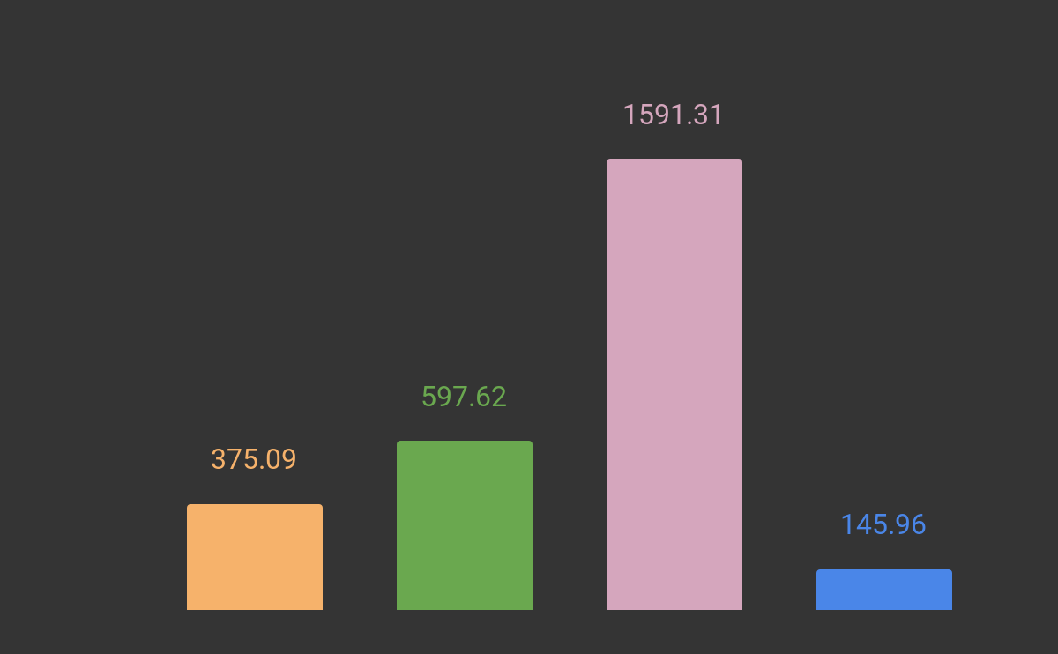
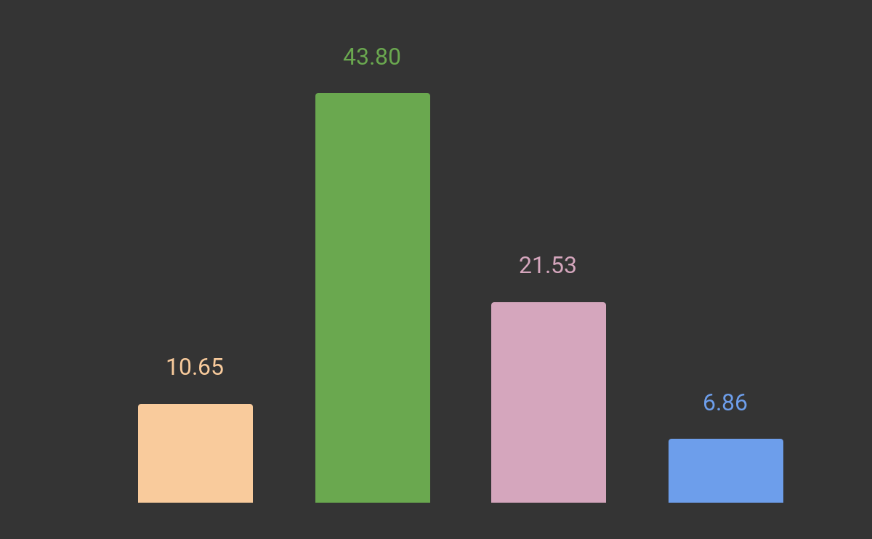
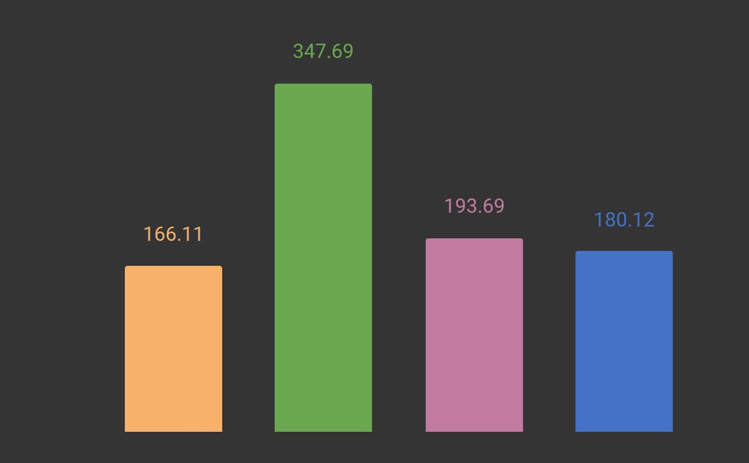
Averages Across Key KPIs for different segments:
Cluster 3 has the highest number of average printer days while cluster 4 has the lowest
Cluster 2 has the highest number of average subscription days while cluster 4 has the lowest
Cluster 2 has the highest
number of average product price while cluster 1 has the lowest
Cluster 1
Cluster 1
Cluster 2
Cluster 3
Cluster 4
Cluster 1
Cluster 2
Cluster 4
Cluster 3
Cluster 4
Cluster 2
Cluster3
Notes:
Some of the Key KPIs on which we can see the difference between the clusters have been visualized here. Appendix 2 has the average values of all the KPIs on which the k-means clustering was created

Slide 16
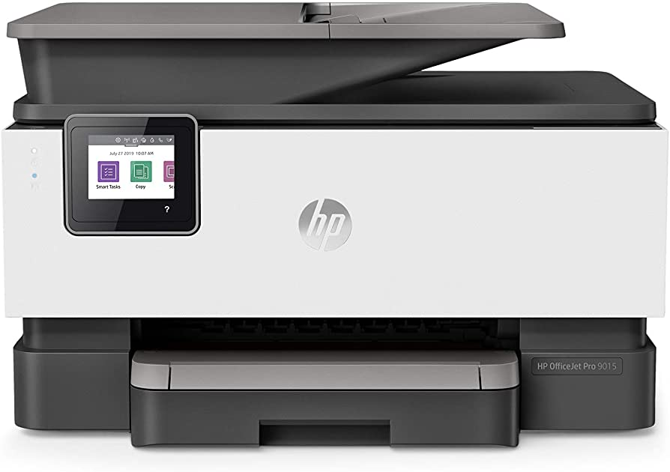
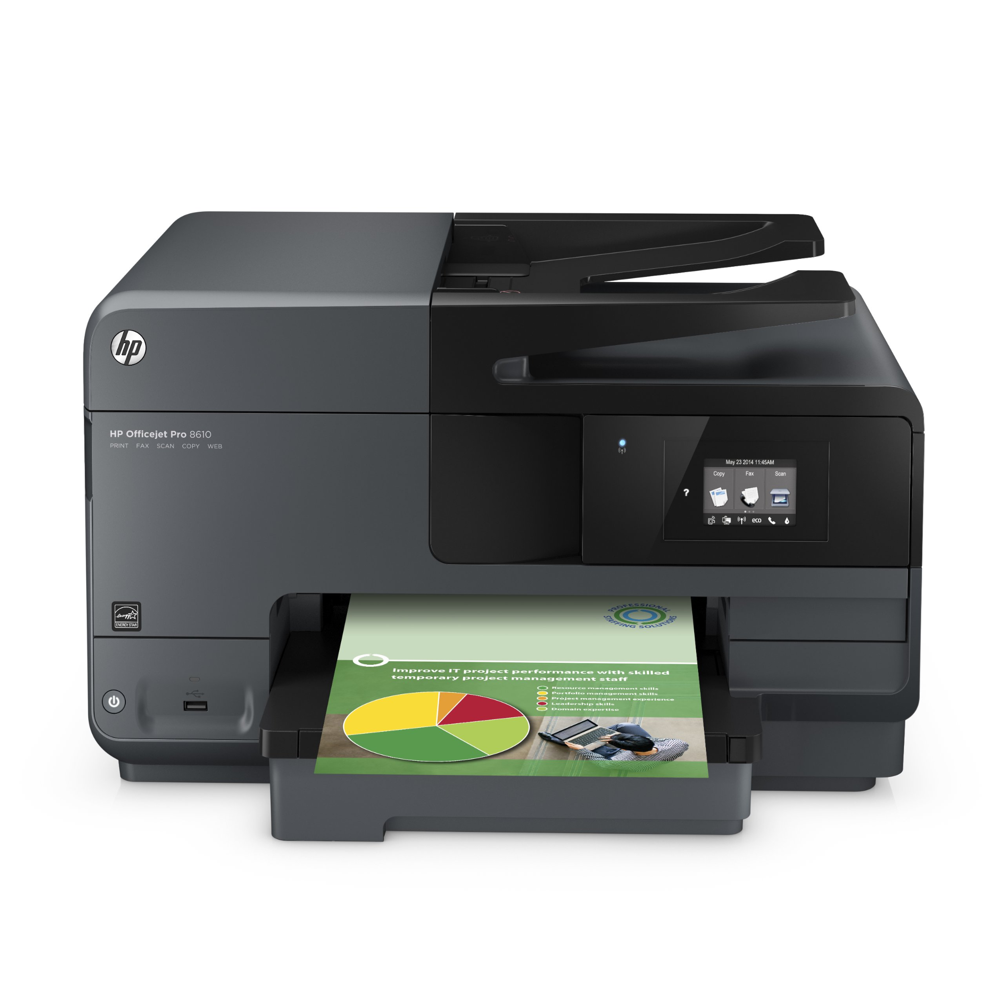
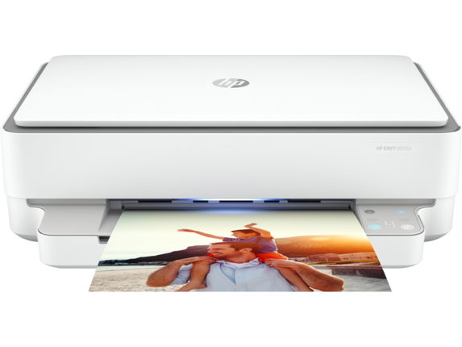
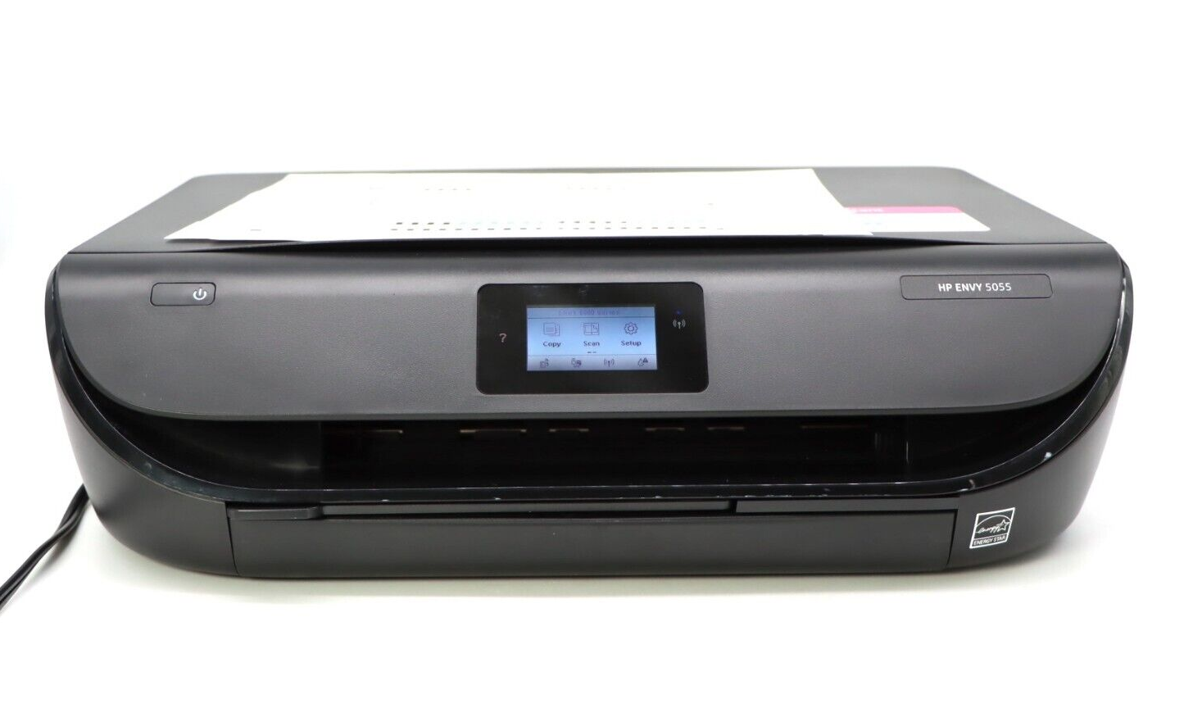
Top Printers By Segment
Cluster 1:
HP ENVY 5055 All-in-One Printer ( $119, Used By 7% of base)
Cluster 2:
HP OfficeJet Pro 9015 All-in-One Printer ($233, Used By 11% of base)
Cluster 3:
HP Officejet Pro 8610 e-All-in-One Printer ( $248, Used By 6% of base)
Cluster 4:
HP ENVY 6055 All-In-One Printer ( $132, Used By 6% of base)
Recommendation:
We identified the top 5 high-end printers which are popular within each segment
We recommend promoting the 5 printers for these segments and upsell them to customers within the segment
Notes:
We identified the top 5 printers for each cluster and on this slide we have visualized only the top printer in each cluster. On a detailed analysis, we identified within the top 10 most frequently bought printer, the top 5 printers which were the most expensive. These printers are a good case for upsell as similar profile of customers are using these printers. The 5 identified printers for recommendation are a good mix of office and home use printers within each cluster which will cater to both the types of customers within each cluster.

Slide 17
Printer Recommendations:
Cluster 1
Cluster 2
Printer | Cost | Cluster Share
HP OfficeJet Pro 8035 All-in-One Printer | $229 | 5%
HP ENVY Photo 7155 All-in-One Printer | $210 | 4%
HP OfficeJet Pro 8028 All-in-One Printer | $192 | 4%
HP OfficeJet Pro 8025 All-in-One Printer | $171 | 6%
HP ENVY Pro 6455 All-in-One Printer | $149 | 4%
Printer | Cost | Cluster Share
HP OfficeJet Pro 7740 Wide Format All-in-One Printer | $612 | 5%
HP OfficeJet Pro 9025 All-in-One Printer | $341 | 9%
HP OfficeJet Pro 8720 All-in-One Printer | $314 | 4%
HP OfficeJet Pro 9018 All-in-One Printer | $256 | 6%
HP OfficeJet Pro 6978 All-in-One Printer | $245 | 5%
Cluster 3
Cluster 4
Printer | Cost | Cluster Share
HP Officejet Pro 8610 e-All-in-One Printer | $248 | 6%
HP ENVY 7640 e-All-in-One Printer | $246 | 6%
HP OfficeJet Pro 6978 All-in-One Printer | $245 | 5%
HP OfficeJet Pro 8710 All-in-One Printer | $230 | 5%
HP ENVY 5660 e-All-in-One Printer | $185 | 5%
Printer | Cost | Cluster Share
HP OfficeJet Pro 9018 All-in-One Printer | $256 | 4%
HP OfficeJet Pro 9015 All-in-One Printer | $233 | 6%
HP ENVY Pro 6455 All-in-One Printer | $149 | 4%
HP ENVY 6055 All-In-One Printer | $132 | 6%
HP ENVY 5055 All-in-One Printer | $119 | 3%
Notes:
We identified the top 5 most popular and high-end printers within each cluster and recommend upselling these to the customers within each cluster. Detailed analysis in Appendix 3.

Slide 18
Customer Segmentation by Demographic
Segment 1
Segment 3
Majority Female
Most completed college
~23%in $100K-$125K income range
Most common occupation- Clerical/ White Collar
87,839 Customers
Largest, Majority Male
Most fall in $30K-$50K income range
Most common occupation- Craftsman/Blue Collar
41,349 Customers
Segment 4
31,029 Customers
57,435 Customers
Majority Male
Most completed college
Most Educated with highest count of graduate college
Most common occupation- Administration/Managerial
~30% Retired
Majority Male
Lower level of Education, Most complete High School
Most common occupation- Craftsman/Blue Collar
Segment 2
Notes:
To cluster customers by demographics, we decided to use the following attributes-gender, education, household income, zip code, and occupation. All these variables are categorical in the HP Dataset
Then, we pre-processed the data by removing the missing values, ending up with about ~250k rows of data.
We selected the k-modes algorithm as our clustering technique since it can handle categorical data by minimizing the dissimilarity between categorical variables. To determine the optimal number of clusters, we used the elbow method. We plotted the number of clusters against the within-cluster sum of squares (WCSS), which is a measure of how much the clusters deviate from their centroids. We found the elbow point where the addition of another cluster didn't significantly improve the model, which turned out to be 4 clusters.
Lastly,, we performed the clustering using the k-modes algorithm with 4 clusters. The output of the clustering algorithm was a set of clusters, each containing a group of customers with similar demographics.
Based on the results of the k modes clustering, you have four distinct clusters or segments. Here is a breakdown of each cluster based on the information provided:
OBSERVED CLUSTER ATTRIBUTES:
Segment 1 is the largest cluster with 87,839 customers, and it is dominated by male customers (76,500) who have completed high school or college. These customers are primarily employed in craftsman/blue-collar or sales/service jobs, and their household income falls within the $30,000 to $74,999 range. This cluster appears to represent the average customer with no distinguishing characteristics.
Segment two has 57,435 customers, with most customers having a highschool degree as the highest education, and have a household income in the $30,000 to $99,999 range. This cluster has most common occupation as craftsman, blue collar
Segment three is the third-largest cluster, with 41,349 customers. The majority of these customers are female who have completed college. They are primarily employed in clerical/white-collar, administration/managerial, or sales/service jobs, and their household income falls within the $50,000 to $124,999 range. This cluster represents customers who are more educated and higher-earning than those in Segment two and one on average.
Segment four has the smallest number of customers, with only 31,029. The majority of these customers are male who have completed graduate degree . They are primarily employed in administration/managerial or are retired. This cluster represents the higher-income customers who are more educated and more likely to have jobs in the skilledr sector.

Slide 19
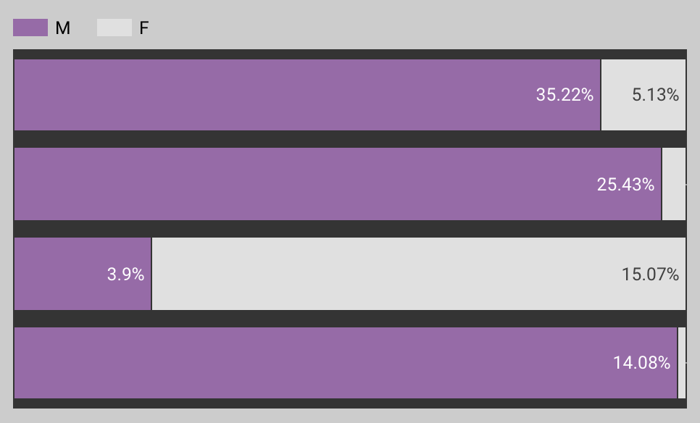
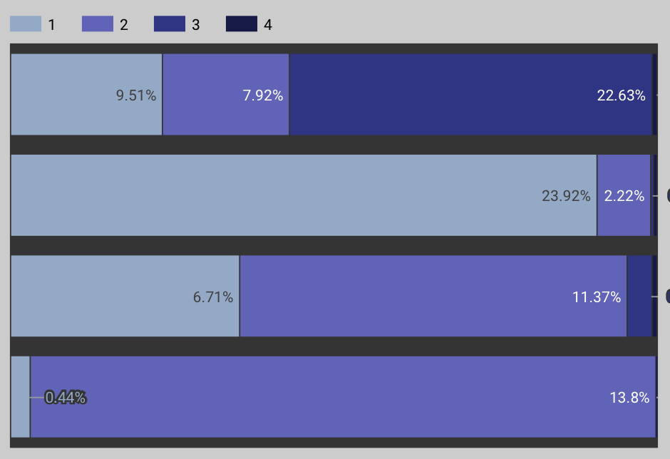
Customer Segmentation by Demographic
Segment 1
Segment 2
Segment 3
Segment 4
Segment 1
Segment 2
Segment 3
Segment 4
Gender Distribution
Education Level Distribution
Notes:
Visualizing the insights highlighted in the previous slide in in Looker.
PS- We only considered Male and Female Gender as the count of data for Unisex Gender was less than 0.01%
https://lookerstudio.google.com/reporting/78761179-07d3-4251-93f0-2f3af0cbaebd

Slide 20
Customer Segmentation by Demographic
Recommendations
Most Common Occupation by Cluster
Targeted Marketing: Based on education level and job skill level. For example, for Segment 3 with more Clerical and administrative jobs, HP could highlight technical specification of a printer model and how it can enhance work productivity
Tailored Offers: Based on demographics and Income Level. For example, for Segment 4, which consists of customers with higher household incomes, HP can offer premium products and exclusive discounts.
Social media targeting: HP can use social media platforms to target specific clusters based on their demographics and online behavior.
Segment 1 | Segment 2 | Segment 3 | Segment 4
Professional | Craftsman/ Blue Collar | Clerical/ White Collar | Administration/ Managerial
Technical | Sales/ Service | Administration/ Managerial | Retired
Notes:
Visualized on Looker and added findings in table form. Top Occupation demographic for each cluster.
Finally, we added a few recommendations on how HP can use clustering to cluster new customers and make inferences based on key traits of that cluster to create targeted marketing and sales startegies

Slide 21




Identifying key drivers of Re-purchase using Random Forest
Top drivers of Repurchase:
Methodology
Subset of customers who purchased printer more than once
Tagged customers with next purchase date greater than previous purchase date
These tagged customers are actual re-purchasers
Total Printer Days: Days Between First Report and Last Report
Days: No. of Days Printer Reported Telemetry
Trade CC: Total Ink Used
HP CC: HP Ink Used
HP Share: Share of HP Ink Used
Model Training and Testing
Used usage and activity data of previous printer
Computed customer's propensity of buying a printer using Random Forest model
Trained on 80% of the data, Validated on 20%
Result:
Train set accuracy: 72%
Test set accuracy: 71%
Identified key drivers of repurchase using variable importance from Random Forest model
Notes:
The model was created on the data of customers who purchased more than once. In this base we identified the customers who may have bought multiple printers together or within a span of a few months of previous purchase. To identify the customers who bought the next printer after their previous printer became obsolete, we tagged all the customers whose previous printer’s last usage date was less than the next printer’s first usage date. First usage Date was considered a proxy for purchase date as this information was not readily available. Out of the 62K customers who have bought more than one printer, 23K were identified as having bought the next printer after their previous printer became obsolete. We trained a random forest model by dividing this dataset into 80% training and 20% validation dataset. The feature importance were obtained in Python by using the sci-kit learn package feature_importances_ function. Plot of feature importance is included in the Appendix 4.

Slide 22
Thank You

Slide 23
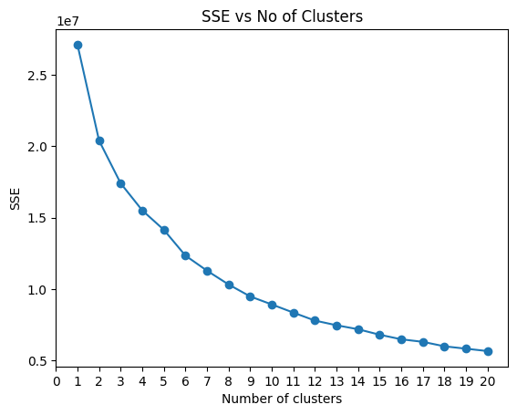
Appendix 1: Elbow Curve of Usage Clusters

Slide 24
Appendix 2: Cluster Summary for Usage Cluster
cluster | Count | product_count | product_price | ampv | ave_cc_mo | blk_cc_mo | color_cc_mo | hp_share | days | trade_cc | hp_cc | total_printer_days | total_subscription_days | percent_usage | percent_days_subscribed
1 | 1,066,609 | 1.02 | 166.11 | 82.83 | 3.92 | 2.27 | 1.65 | 0.97 | 384.09 | 30.21 | 28.94 | 375.09 | 10.65 | 0.99 | 0.04
2 | 97,456 | 1.26 | 347.69 | 726.41 | 32.86 | 19.12 | 13.00 | 0.82 | 613.81 | 364.40 | 344.59 | 597.62 | 43.80 | 0.84 | 0.11
3 | 243,293 | 1.07 | 193.69 | 97.35 | 4.76 | 2.79 | 1.97 | 0.92 | 1598.28 | 194.02 | 179.43 | 1591.31 | 21.53 | 0.95 | 0.02
4 | 528,714 | 1.01 | 180.12 | 49.67 | 2.52 | 1.35 | 1.16 | 0.01 | 157.91 | 1.84 | 0.25 | 145.96 | 6.86 | 0.81 | 0.08

Slide 25
Appendix 3: Current top 5 printers and our recommendation
Top 5 Printers By Cluster Currently
Cluster | Printer | Cost | Count | Avg Cost |  | Cluster | Printer | Cost | Count | Avg Cost |  | Cluster | Printer | Cost | Count | Avg Cost |  | Cluster | Printer | Cost | Count | Avg Cost
0 | HP ENVY 5055 All-in-One Printer | 9,155,076 | 76,650 | 119 |  | 1 | HP OfficeJet Pro 9015 All-in-One Printer | 2,505,114 | 10,729 | 233 |  | 2 | HP Officejet Pro 8610 e-All-in-One Printer | 3,616,803 | 14,588 | 248 |  | 3 | HP ENVY 6055 All-In-One Printer | 4,129,867 | 31,351 | 132
0 | HP OfficeJet Pro 8025 All-in-One Printer | 11,255,063 | 65,965 | 171 |  | 1 | HP OfficeJet Pro 9025 All-in-One Printer | 3,040,137 | 8,928 | 341 |  | 2 | HP ENVY 7640 e-All-in-One Printer | 3,510,420 | 14,272 | 246 |  | 3 | HP OfficeJet Pro 9015 All-in-One Printer | 6,986,169 | 29,920 | 233
0 | HP ENVY Photo 7855 All-in-One Printer | 7,099,933 | 64,982 | 109 |  | 1 | HP OfficeJet Pro 8710 All-in-One Printer | 1,910,505 | 8,306 | 230 |  | 2 | HP OfficeJet Pro 8710 All-in-One Printer | 2,968,287 | 12,904 | 230 |  | 3 | HP OfficeJet Pro 9018 All-in-One Printer | 6,061,824 | 23,679 | 256
0 | HP OfficeJet Pro 8035 All-in-One Printer | 13,145,901 | 57,514 | 229 |  | 1 | HP OfficeJet Pro 8025 All-in-One Printer | 1,002,051 | 5,873 | 171 |  | 2 | HP OfficeJet 4650 All-in-One Printer | 1,137,986 | 11,770 | 97 |  | 3 | HP ENVY Pro 6455 All-in-One Printer | 3,263,032 | 21,857 | 149
0 | HP OfficeJet 5255 All-in-One Printer | 5,528,747 | 55,293 | 100 |  | 1 | HP OfficeJet Pro 8035 All-in-One Printer | 1,251,897 | 5,505 | 227 |  | 2 | HP ENVY 4520 All-in-One Printer | 1,169,669 | 11,698 | 100 |  | 3 | HP DeskJet Plus 4155 All-in-One Printer | 2,065,731 | 20,322 | 102
Top 5 Printers We Recommend
Cluster | Printer | Cost | Count | Avg Cost |  | Cluster | Printer | Cost | Count | Avg Cost |  | Cluster | Printer | Cost | Count | Avg Cost |  | Cluster | Printer | Cost | Count | Avg Cost
0 | HP OfficeJet Pro 8035 All-in-One Printer | 13,145,901 | 57,514 | 229 |  | 1 | HP OfficeJet Pro 7740 Wide Format All-in-One Printer | 3,061,419 | 5,006 | 612 |  | 2 | HP Officejet Pro 8610 e-All-in-One Printer | 3,616,803 | 14,588 | 248 |  | 3 | HP OfficeJet Pro 9018 All-in-One Printer | 6,061,824 | 23,679 | 256
0 | HP ENVY Photo 7155 All-in-One Printer | 8,582,874 | 40,830 | 210 |  | 1 | HP OfficeJet Pro 9025 All-in-One Printer | 3,040,137 | 8,928 | 341 |  | 2 | HP ENVY 7640 e-All-in-One Printer | 3,510,420 | 14,272 | 246 |  | 3 | HP OfficeJet Pro 9015 All-in-One Printer | 6,986,169 | 29,920 | 233
0 | HP OfficeJet Pro 8028 All-in-One Printer | 8,342,784 | 43,452 | 192 |  | 1 | HP OfficeJet Pro 8720 All-in-One Printer | 1,309,525 | 4,167 | 314 |  | 2 | HP OfficeJet Pro 6978 All-in-One Printer | 2,693,890 | 11,013 | 245 |  | 3 | HP ENVY Pro 6455 All-in-One Printer | 3,263,032 | 21,857 | 149
0 | HP OfficeJet Pro 8025 All-in-One Printer | 11,255,063 | 65,965 | 171 |  | 1 | HP OfficeJet Pro 9018 All-in-One Printer | 1,382,400 | 5,400 | 256 |  | 2 | HP OfficeJet Pro 8710 All-in-One Printer | 2,968,287 | 12,904 | 230 |  | 3 | HP ENVY 6055 All-In-One Printer | 4,129,867 | 31,351 | 132
0 | HP ENVY Pro 6455 All-in-One Printer | 6,481,575 | 43,416 | 149 |  | 1 | HP OfficeJet Pro 6978 All-in-One Printer | 1,198,834 | 4,901 | 245 |  | 2 | HP ENVY 5660 e-All-in-One Printer | 2,055,720 | 11,112 | 185 |  | 3 | HP ENVY 5055 All-in-One Printer | 1,835,912 | 15,371 | 119

Slide 26
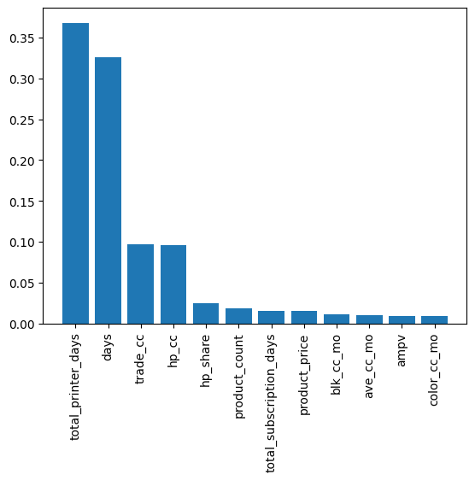
Appendix 4: Random Forest Variable Importance

